Slide 1
List
Data Types in Python Part 2
By Dr Shantanu Pathak
Ref : https://docs.python.org/3/library/stdtypes.html

Slide 2
Contents
Introduction
Sequences in Python
List Data type & Operations

Slide 3
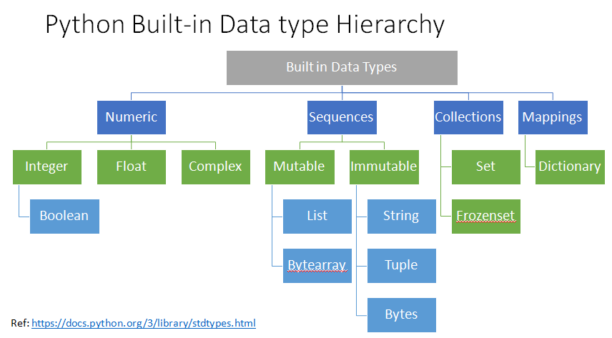

Slide 4
Python Basic Data types
Data type | Mutable / Immutable | Size | Order | Hierarchy
int | Immutable | Dynamic | - | Numeric
float | Immutable | Fix | - | Numeric
complex | Immutable | Fix | - | Numeric
bool | Immutable | Fix | - | Numeric
str (string) | Immutable | Fix | Ordered | Sequence
tuple | Immutable (*Special case) | Fix | Ordered | Sequence
list | Mutable | Dynamic | Ordered | Sequence
set | Mutable | Dynamic | Un-ordered | Collections
dict | Mutable | Dynamic | Ordered | Mappings
bytes | Immutable | Fix | Ordered | Sequence
bytearray | Mutable | Dynamic | Ordered | Sequence
frozenset | Immutable | Fix | Un-ordered | Collections

Slide 5
Concept of Sequences
Any data type which supports sequential storing more than one value is considered as a sequence
Sequences have order in their elements
Sequential Data types are
List , bytearray , string (str) , tuple, bytes
In ALL Sequences Index starts from 0 and NOT 1
All sequences support few common operations

Slide 6
List Data Type & Operations

Slide 7

What is a list?
Like an array
Can store multiple values in a sequence
We can access / modify values directly or using index or by slicing
There is a linear ordering to the elements
Ex.

Slide 8
Uniqueness of List Data type
One of the most flexible data types in python
Its like and array in C programming
Can store any type of data in any sequence ( Mix type elements are allowed)
Ex. Int, string, list, tuple, dict , user defined data types, etc
Mutable Sequence data type so memory is dynamically allocated
Mutable Sequence data type so can add / modify / delete elements
New list can be created by using list() constructor or by direct assignment
DON’T use ‘list’ variable name because its built-in constructor in python
Every element in list is a place holder / object reference to an object
Any element in a list can be updated with any value

Slide 9
Why list can have any data type stored???
list is, list of object references
Python uses Object references and not pointers
hazards of pointers in c
Memory leak
Cyber attacks
Memory overflow error
L1
Obj1
Obj2
Obj3

Slide 10
Creating Lists (sample methods)
Method 1
L1 = list() # empty list created
Method 2
L1 = [10,20,30] #direct assignment
Method 3
L2 = [] # empty list
for num in range(1,5):
L2.append(num) # each time append one number to list
print(L2) #[1,2,3,4]
Method 4 ( and there are many more other methods ..)
Use list comprehension

Slide 11
Printing Lists (sample methods)
print(l1)
for idx in range(len(l1)): #idx gives index of list elements
print(l1[idx])
for element in l1: # element gives one element at a time
print(element)
for idx, element in enumerate(l1): # idx gives index & element gives one element
print(idx, element)

Slide 12
List Comprehension
Efficient way of creating, and filtering lists
Has special syntax
Ex. L1=[5,2,8]
Select all elements from list L1 which are greater than 3
L2 = [ element for element in L1 if element > 3]
Ex. Square all elements of list L1
L3 = [ e * e for e in L1 ]
Ex. Put elements from l1 which are greater than 3, else put None
L4= [ e if e > 3 else None for e in l1]

Slide 13
List Comprehension
Why to use list comprehension?
List comprehensions are faster than creating list using for loop
List comprehensions do not use function to append elements
So, time for function call loading and unloading is saved **
https://docs.python.org/3.10/faq/design.html#how-are-lists-implemented-in-cpython

Slide 14
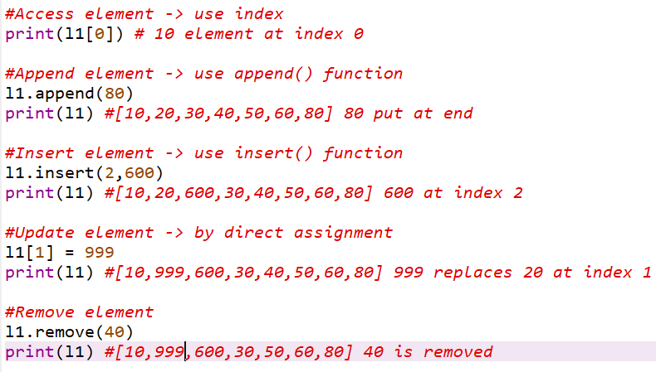
How to append, access, update, insert or remove element from list?

Slide 15
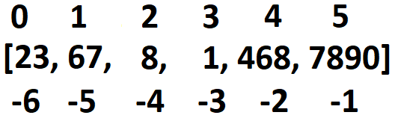
List Indexing
Python allows +ve as well as –ve indexing in sequences
+ve index :
left to right
Starts from 0
-ve index :
Right to left
Starts from -1
Logically, it represents position from last, where -1 is last, -2 is second last, -3 is 3rd from last, etc
Both index can be used to select elements from sequence or slice the sequence
Ex. L1 = [23,67,8,1,468,7890]
print(L1[2], L1[-1]) -> 8 , 7890
Trying to access Index larger than length of list will result in error
Ex. In above example L1[6] -> will give error because indexes are between 0 to 5

Slide 16
List Slicing (Slicing in sequences) in python
Slicing or extracting part of list based on indexes is an important feature of any sequences in Python
Slicing creates shallow copy in lists and view in advanced libraries like pandas and numpy
So, slicing in lists takes more memory

Slide 17
List Slicing Syntax
Using following syntax list is cut (sliced) and shallow copy of that part of list is returned
Slicing is done using [ ] or using slice()
There are three parameters : start : end : step
start value is included
end value is excluded
step =1 by default ( if not given explicitly)
Ex. l1 = [10,20,30,40,50,60] ## len(l1) is 6
l1[2:4] ->
l1[-5:-1]->
Only start is given
Only End is given
-ve Value of Step
Reversing list using –ve step value

Slide 18
List Slicing Special Cases
l1 = [10,20,30,40,50,60] ## len(l1) is 6
Special cases :
Wrong start and stop pair as per step (Home Work)
l1[4:1:1]
l1[1:4:-1]
Start and Stop have mix of positive and negative values
l1[-4:5] # allowed -> negative value is added length of list and final value is used
No value is given only slicing syntax is written
l1[::] # allowed ->gives shallow copy of list
Out of bound values of start, end and step
l1[:100], l1[300:], l1[::200] # allowed ->Home Work
When complete list is selected using slicing
Shallow copy of list object is returned
l1 is l1[:] -> returns false

Slide 19
How to Copy a List completely?
There are two types of copies created in python
Shallow Copy
Copy all references inside a list to new location in memory
Requires extra memory as separate copy is created
Modification to original copy doesn’t affect the list (for immutable objects in list)
Mutable objects will have shared reference in original and shallow copy
Syntax -> list_s = l1.copy() or l2 = l1[:]
Copy by Assignment (deep copy old concept)
Assignment statements in Python do not copy objects, they create bindings between a target and an object.
New reference to existing sequence is created
No need of extra memory because ONLY new reference is created
Changes in original will affect copy totally because both original and new are referring same object internally
Syntax -> list_d = l1
NOTE: deepcopy() function from copy.py library is different!!

Slide 20
How to Copy a List completely?
(Generic) Deep Copy using copy.py library
constructs a new object in memory
For all mutable objects inside original object
creates a copy at new memory location
Then, puts new references in new object
For all immutable objects inside original object
Copy the same reference to new object
Example: Graphic explanation of list within list, copy.deepcopy()
NOTE : You need to import copy library to do this
Ref: https://docs.python.org/3/library/copy.html

Slide 21
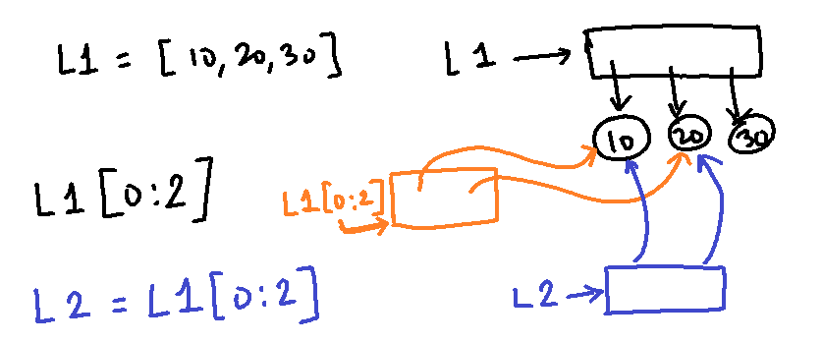
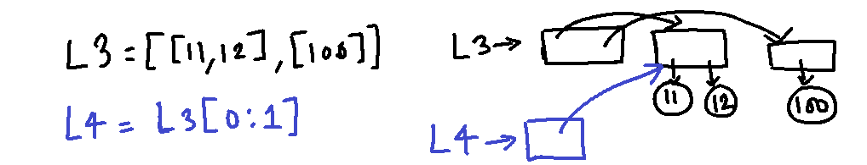
How to Copy a part of List ?
Slice of list can be used on right hand side of assignment operation
This creates a copy of that part of list as a new object
In case list contains mutable objects, then:
Similar working happens in case of shallow copy

Slide 22
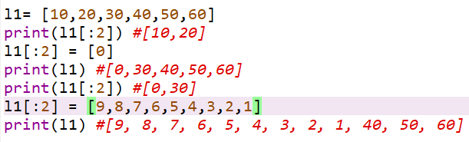
How to modify a part of List ?
Size of left side and right side can be different in lists
Whatever iterable on right side is assigned to left side part
Iterable can be of any type (list/tuple/string/set/dict(keys)/bytes/bytesarray)

Slide 23
List Operations ( common operations for mutable sequences)
Operation | Syntax | Result
Membership | x in s | True if an item of s is equal to x, else False
Membership | x not in s | False if an item of s is equal to x, else True
Concatenation | s + t | the concatenation of two sequences, s and t
Add n times | s * n or n * s | equivalent to adding s to itself n times
Access element | s[i] | ith index item of s, origin 0
Slicing | s[i:j] | slice of s from index i to j
Slicing with step | s[i:j:k] | slice of s from index i to j with step k
Length | len(s) | length of s
Minimum | min(s) | smallest item of s
Maximum | max(s) | largest item of s

Slide 24
List Operations ( common operations for mutable sequences)
Operation | Syntax | Result
Search Element | s.index(x[, i[, j]]) | index of the first occurrence of x in s (at or after index i and before index j)
Count | s.count(x) | total number of occurrences of x in s
Check all are True | all(s) | if all values in sequence s are non-zero (TRUE) then return TRUE, else FALSE
Check Any True | any(s) | if any value in sequence s is TRUE then return TRUE else return FALSE
Modify Element | s[i] = x | item i of s is replaced by x
Modify Slice | s[i:j] = t | slice of s from i to j is replaced by the contents of the iterable t
Delete Slice | del s[i:j] | Deletes all elements from index I to j, same as s[i:j] = []
Modify Slice with Step | s[i:j:k] = t | the elements of s[i:j:k] are replaced by those of t

Slide 25
List Operations ( common operations for mutable sequences)
Operation | Syntax | Result
Delete Slice | del s[i:j:k] | removes the elements of s[i:j:k] from the list
Append element | s.append(x) | appends x to the end of the sequence (same as s[len(s):len(s)] = [x])
Clear all elements | s.clear() | removes all items from s (same as del s[:])
Shallow copy | s.copy() | creates a shallow copy of s (same as s[:])
Concatenation | s.extend(t) or s += t | extends s with the contents of t (for the most part the same as s[len(s):len(s)] = t) (concatenation operation)
Add n Times | s *= n | updates s with its contents repeated n times
Insert at index | s.insert(i, x) | inserts x into s at the index given by i (same as s[i:i] = [x])

Slide 26
List Operations ( common operations for mutable sequences)
Operation | Syntax | Result
Pop an Element | s.pop() or s.pop(i) | By default removes the last element Else retrieves the item at i and also removes it from s
Remove | s.remove(x) | remove the first item from s where s[i] is equal to x
Reverse | s.reverse() | reverses the items of s in place
Sort | l.sort(*,key=None, reverse= False) | sorts the list in place, using only < (less than) comparisons between items.

Slide 27
List Value Unpacking and packing
Unpacking
Python allows multiple value assignment in single statement
Ex. L1 = [10,20]
x,y = L1 #This is possible and value assignment happens left to right
# Here reference of index 0 element from L1 is copied to x
Packing
Python has special case of ‘*’ variable, which allows variable number of values assigned, by concept of packing
Ex. a,*b,c = L1 #allowed b will get empty list, bcz L1=[10,20]
a,*b,c = [23,45,67,89] #allowed here b will get [45,67]
NOTE: here number of values on right should be min, number of variables on left minus 1
NOTE: ONLY ONE ‘*’ variable allowed in one statement on right side

Slide 28
Common How tos for Sequences
How to sort sequences in python?
Sorted() function can be used to sort any sequence
list.sort() is used ONLY for lists
How to search an element in a List ?
Use in operator to check if value is available or not
Ex. l1= [30,20,10]
if(10 in l1):
print(“Available”)
else:
print(“Not available”)
Use index() function

Slide 29
Common How to’s for Sequences
How reverse order of sequence be iterated ?
One way is to use reversed() built-in function
l1.reverse() reverses list l1 itself
l1[::-1] slicing syntax is another method
How do you remove duplicates from a list ?
Use set() function, it converts lists to a set (faster way)
Check every element in loop and delete one by one
How to Select / Remove multiple elements from list ?
Use list comprehension Ex. L2 = [ e if e > 3 for e in l1] #all elements greater than 3 from l1
Use map function
Use for loop

Slide 30
Common How to’s for Sequences
How to create array in Python?
Create List
How to create Multi-Dimensional Lists?
Use for loop or List comprehension
Ex ll = [[] for i in range(3)]
DON’T use ‘*’ operator ( Ex. Multi_list = [ [] * 3 ] -> In this case ‘*’ operator creates deep copies of empty list object. So, three empty lists will be same object reference)

Slide 31
Common How to’s for Sequences
How comparison (==, < , >) works on two lists / sequences ?
The comparison uses lexicographical ordering:
first the first two items are compared
if they are equal, the next two items are compared, and so on,
until either sequence is exhausted.
If all items of two sequences compare equal, the sequences are considered equal.
If one sequence is an initial sub-sequence of the other, the shorter sequence is the smaller (lesser) one.
Example: [1,2,3] is less than [1,2,4]
[1,2,3,4] is greater than [1,2,3]
[1,2] is same as [1.0, 2.0], because numeric values of elements are same
https://docs.python.org/3/tutorial/datastructures.html#comparing-sequences-and-other-types
NOTE : Comparing sequences of different types is not supported, because not logically justified

Slide 32
Common Operations for Sequences (for any sequence Data Types str, list, tuple, bytes, bytearray)
Sr No | Operation | Result
1 | x in s | True if an item of s is equal to x, else False
2 | x not in s | False if an item of s is equal to x, else True
3 | s + t | the concatenation of two sequences, s and t
4 | s * n or n * s | equivalent to adding s to itself n times
5 | s[i] | ith index item of s, origin 0
6 | s[i:j] | slice of s from index i to j
7 | s[i:j:k] | slice of s from index i to j with step k
8 | len(s) | length of s
9 | min(s) | smallest item of s
10 | max(s) | largest item of s
11 | s.index(x[, i[, j]]) | index of the first occurrence of x in s (at or after index i and before index j)
12 | s.count(x) | total number of occurrences of x in s
13 | all(s) | if all values in sequence s are non-zero (TRUE) then return TRUE, else FALSE
14 | any(s) | if any value in sequence s is TRUE then return TRUE else return FALSE

Slide 33
What happens ?
Deleting element while iterating on list in for loop / while loop
While loop on lists

Slide 34
Extra for Lists
NOTE :: Python sorting uses Schwartzian Transform before sorting
Which sorting algorithm is used inside sorted() in python? (Hint:Timsort)
Ref: https://stackoverflow.com/questions/1517347/what-algorithm-does-pythons-built-in-sort-method-use
[::] -> slicing on sequences internally calls __getitem__, __setitem__ and __delitem__ based on the operation being performed
Ref: https://docs.python.org/2/reference/datamodel.html#object.__getitem__
Read what is iterable from Glossary of Python Documentation
Ref: https://docs.python.org/3/glossary.html

